Slide 1
Product
Knowledge
.

Slide 2
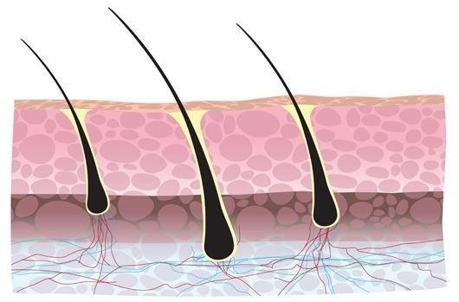
Sterex Products
Contents:
Machines
Pre-care
Needles
Cables
Needle Holders
Chuck Caps
Sterilisation
After-care

Slide 3
Electrolysis & Laser/IPL
ELECTROLYSIS retains the legal affirmation of being THE only permanent method of hair removal and is a brilliant standalone treatment.
However it also complements LASER/IPL treatments and together they make the perfect combination offering speed of treatment with the added benefit of permanency

Slide 4
Electrolysis vs laser
METHOD | ELECTROLYSIS | LASER
What is it | PERMANENT HAIR REMOVAL. Works on any skin colour/hair colour. | PERMANENT HAIR REDUCTION. Does not work in 60% of cases.
How it works | Hair producing cells in the follicle are specifically targeted using current that is delivered directly into the follicle. | Light energy passes through skin and attracted to pigmentation, which is found in dark hair and skin. The energy heats up the pigmentation and surrounding tissue and therefore heats up the follicle.
Face/Body | Effective on any area where hair grows. Suitable for fine through to course hair, light or dark and on all skin types. | IPL/Laser only successfully treats strongly pigmented hair
Pros | Absolutely permanent. Skin improves once hair is gone. Well-suited to delicate face and eyebrow, as well as body work. | Suitable for large areas like arms and legs. Can clear a large area in one appointment. No immediate side effects.
Cons | Large areas require significant investment of time and money. Can be painful on certain body areas. Body treatments produce pinpoint scabs. | Requires ongoing maintenance. Works only on light skin/dark hair combination. Not suitable new hair growth on face and many areas of body.

Slide 5
SX-B Blend Machine
3 in 1 machine
Keypad operation
Digital displays
Simple to use
Timer facility when used with foot pedal
Can be used as a diathermy, galvanic or blend epilator
Effective on curved and distorted follicles
Can treat pigmented skin
Blend combines the effectiveness of galvanic with the speed of diathermy
Various treatment techniques
Highly versatile machine
Notes:
Shorter for higher
Lower for Longer
Treat and leave
Standard setting 4 -5 -20

Slide 6
1 Day SX-B Learning Resource
1 day free training included in the cost of a brand new SX-B
This is an equipment awareness course for electrologists who have purchased a brand new SX-B Epilation machine and want to familiarise themselves with this unit and the range of treatment techniques available.
This is now available as a downloadable learning resource
Please be aware this is not an electrolysis refresher course. If customers want to refresh their electrolysis skills we offer a 1 day electrolysis refresher course at a cost of £200 + vat.
This day covers treatment techniques and benefits of all three modalities, positioning of client, positioning of self, how to make ‘perfect insertions’, tweezer holding techniques, 2 and 3 way stretching as well as hair structure and growth cycle, causes of hair growth, endocrine system, consultation and treatment planning.

Slide 7
SX-T Diathermy Machine
Keypad operation
Digital displays
Simple to use
Quick (recommended 1 – 1 ½ seconds)
Suitable for clients with metal plates & pins
Great for straight follicles
Great for speedy removal
Effective for dry/dehydrated skin

Slide 8
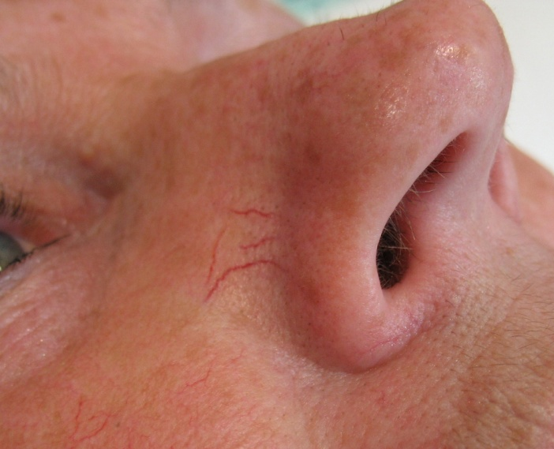
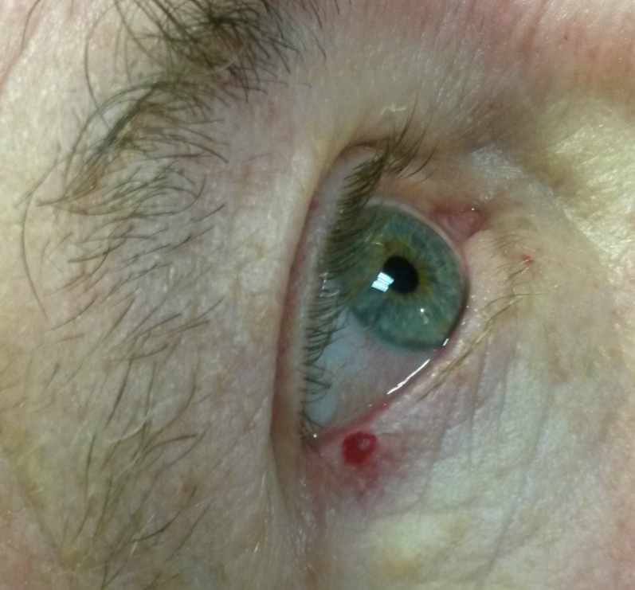
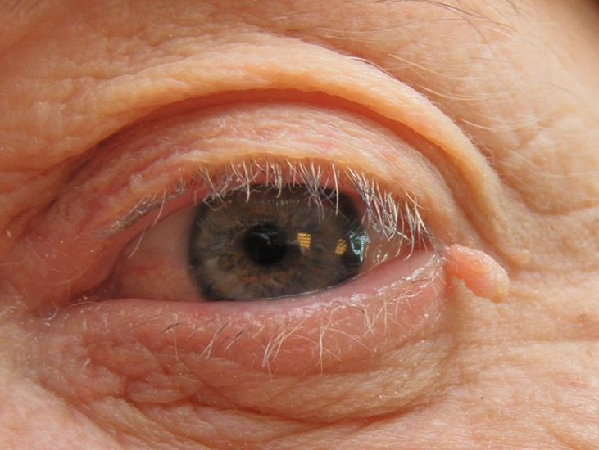
SX-T Diathermy Machine
Produces the necessary high frequency current required for diathermy treatments
Functions to coagulate, cauterise or desiccate vascular, non-vascular and pigmented blemishes
Notes:
If offering hair removal as well as blemish treatments we would recommend the SX-B machine.

Slide 9
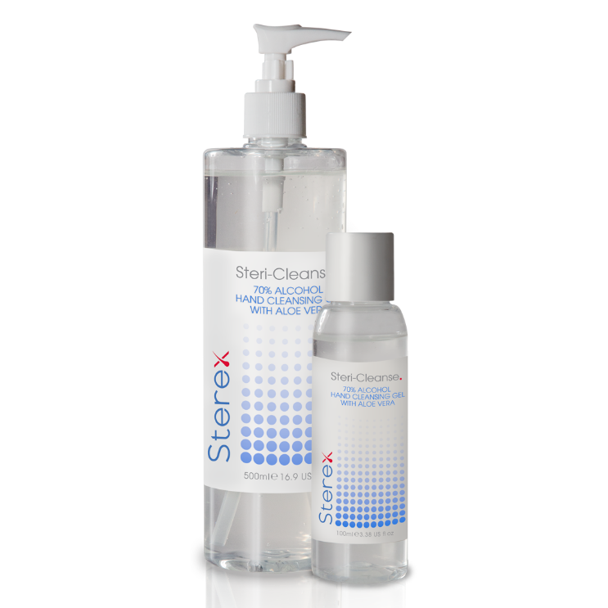
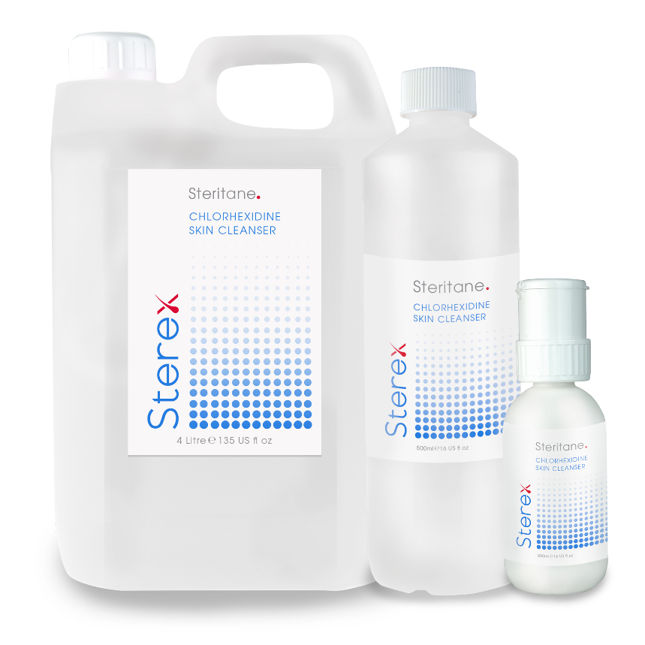
Pre-Care Products

Slide 10
Steritane
Liquid skin cleanser for pre-treatment providing optimum hygiene
Contains skin conditioners from plant sources (coconut)
Contains added humectants preserving moisture in the skin
Contains Chlorehexidine BP to ensure pre-treatment skin disinfection
20 seconds on surface of skin to achieve disinfection
Use prior to and following treatment
Easy to use, no measuring or diluting required
Available in 3 sizes
250ml pump
500ml refill
4 litre refill
Can also be used for cleansing the skin for other treatments, e.g. Waxing, sugaring, laser

Slide 11
Steri-Cleanse
Anti-bacterial hand cleanser
100ml size ideal for those on the move
Keep in the car, handbag, purse or kit bag
Formulated to kill germs
Ideal for cleaning gloved hands prior to treatment and between areas of treatment on the same client
No need to rinse or dry
Available in 100ml and 500ml pump also available

Slide 12
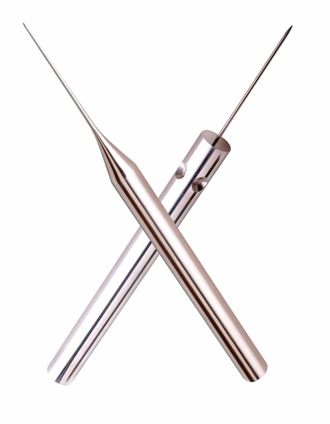
Tools of the Trade - Needles
3 different materials used
Stainless
Gold
Insulated
2 styles
One Piece
Two Piece
2 lengths
Short
Regular
6 sizes
varying in diameter from 2 to 6 (plus 10 for advanced work)

Slide 13
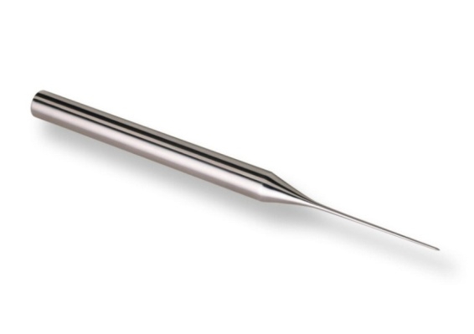
One-piece Needles
Manufactured from medical grade stainless steel
Rigid needle
Useful for shallow insertions, particularly fine vellus hair
Robust needle
Excellent for hair removal & advanced work
Available in sizes 2, 3, 4 & 5

Slide 14
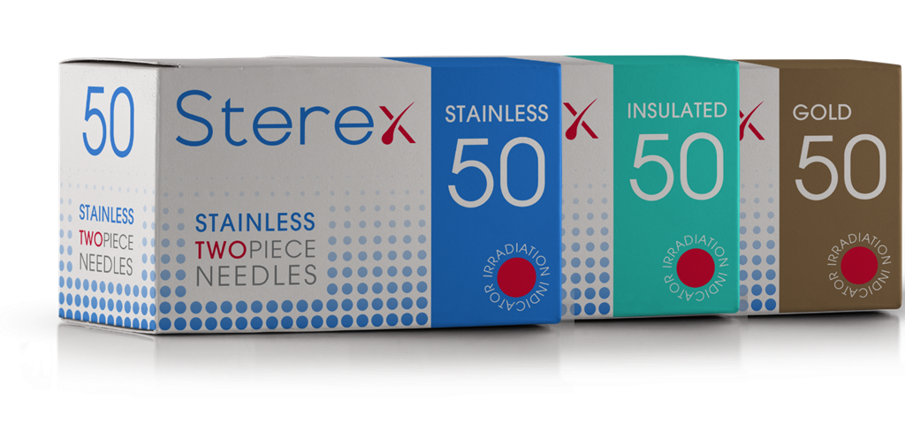
Two-piece Needles
Available in 3 materials
Provides invaluable ‘follicle feedback’
Will flex when meets resistance
If resistance met electrologist then able to re-adjust their probing angle

Slide 15
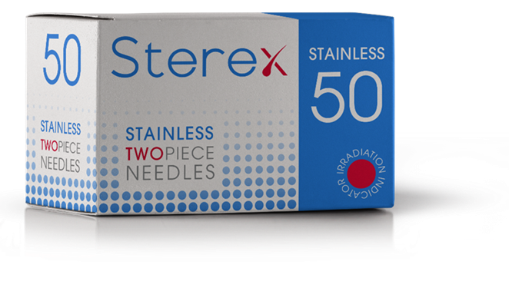
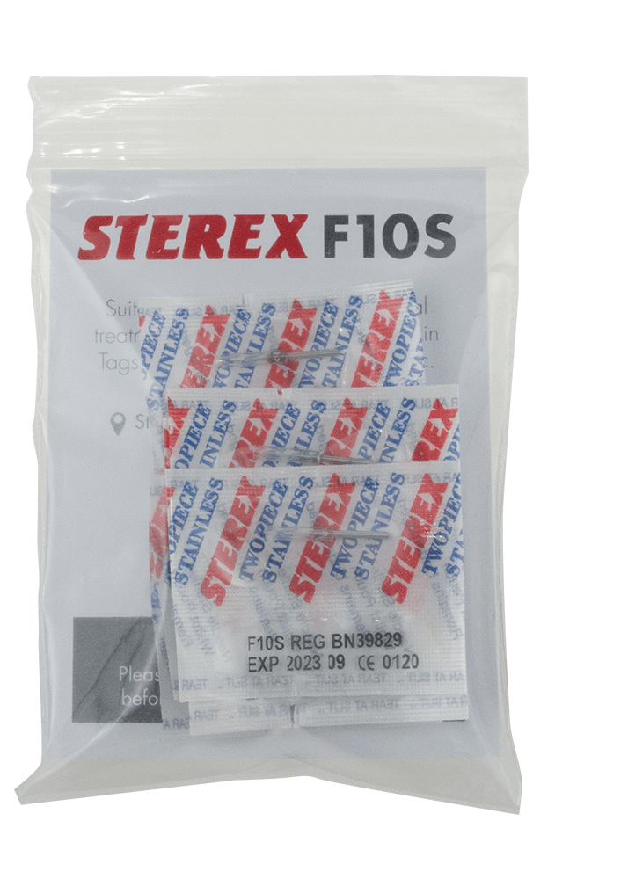
Stainless Needles
Best selling two-piece needle
Manufactured from medical grade stainless steel
Provides essential flexibility and feel
Less chance of inaccurate probing as needle will bend if meets resistance
Available in sizes 2,3,4,5,6 & 10 (size 2 in short only)
Specialist size 10 suitable for advanced treatments which are available in packs of 10 and boxes of 50

Slide 16
Gold Needles
Manufactured from medical grade stainless steel
Offers a smooth insertion
Gold is capable of conducting current better than most other metals which means the current may be reduced
Suitable for clients with sensitive skin
Suitable for clients with allergies to nickel or stainless steel
Suitable for Afro-Caribbean and Asian skin types who may have a tendency to pigmentation marks
Suitable for Diabetic clients when the skin has a lower pain threshold
Available in sizes 2, 3, 4 & 5 (size 2 in short only)

Slide 17
Insulated Needles
Manufactured from medical grade stainless steel
For use with thermolysis only
75% of the shaft is coated with an insulating material
Only tip of needle exposed so current flows to the lower follicle and papilla only
Destruction is limited to around the tip of the needle
Surface reaction is reduced or prevented
Suitable for clients with sensitive skin or prone to pigmentation

Slide 18
Needle Holders
Finger button switch to release the current
Less control as the index finger cannot be used to control the needle holder as it is pressing the button
In UK the finger button is taught in most FE colleges
Compatible with detachable cable with BNC connector or Jack Plug connector
BNC Black cable

Slide 19
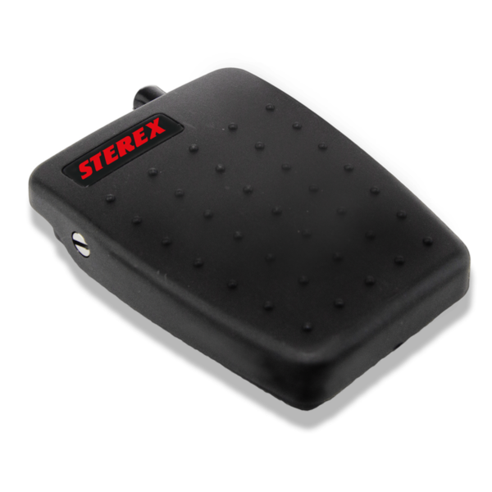
Needle Holders
Non Switched Needle Holder
Used with a foot pedal
Offers more control of needle holder
Ideal for advanced work
Compatible with detachable cable with BNC connector or Jack Plug connector

Slide 20
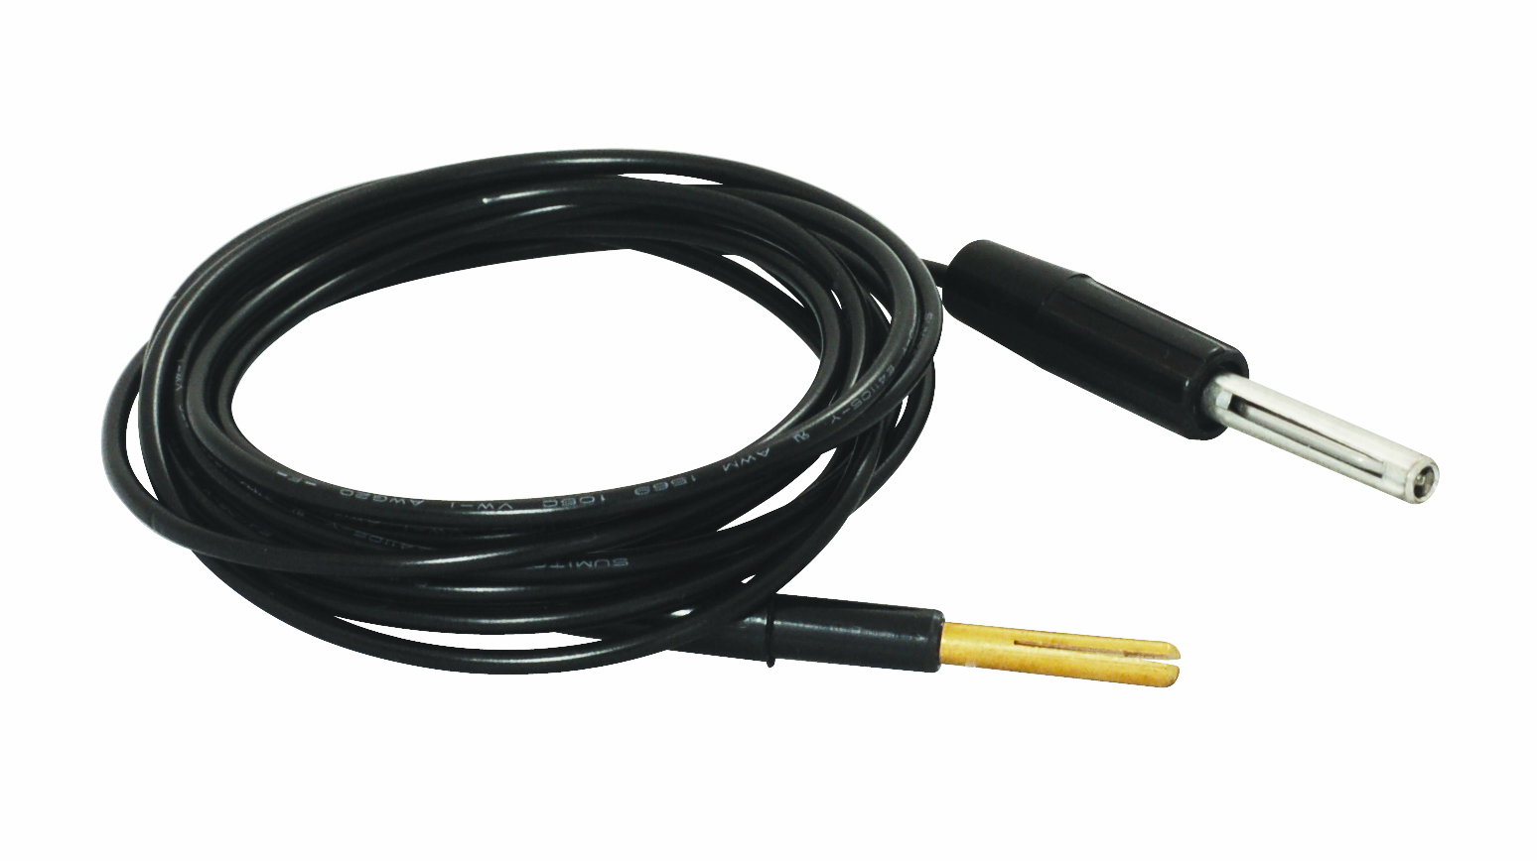
Cables
Flexible
Separate from the needle holder
If cable breaks you do not need to replace the complete unit
Jack Plug (Banana) black cable

Slide 21
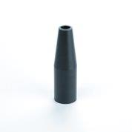
Chuck Caps
New sterilised cuck cap for each client
Available in packets of 5
Autoclave compatible
Ensure they are dry prior to placing on the needle holder to avoid discolouration

Slide 22
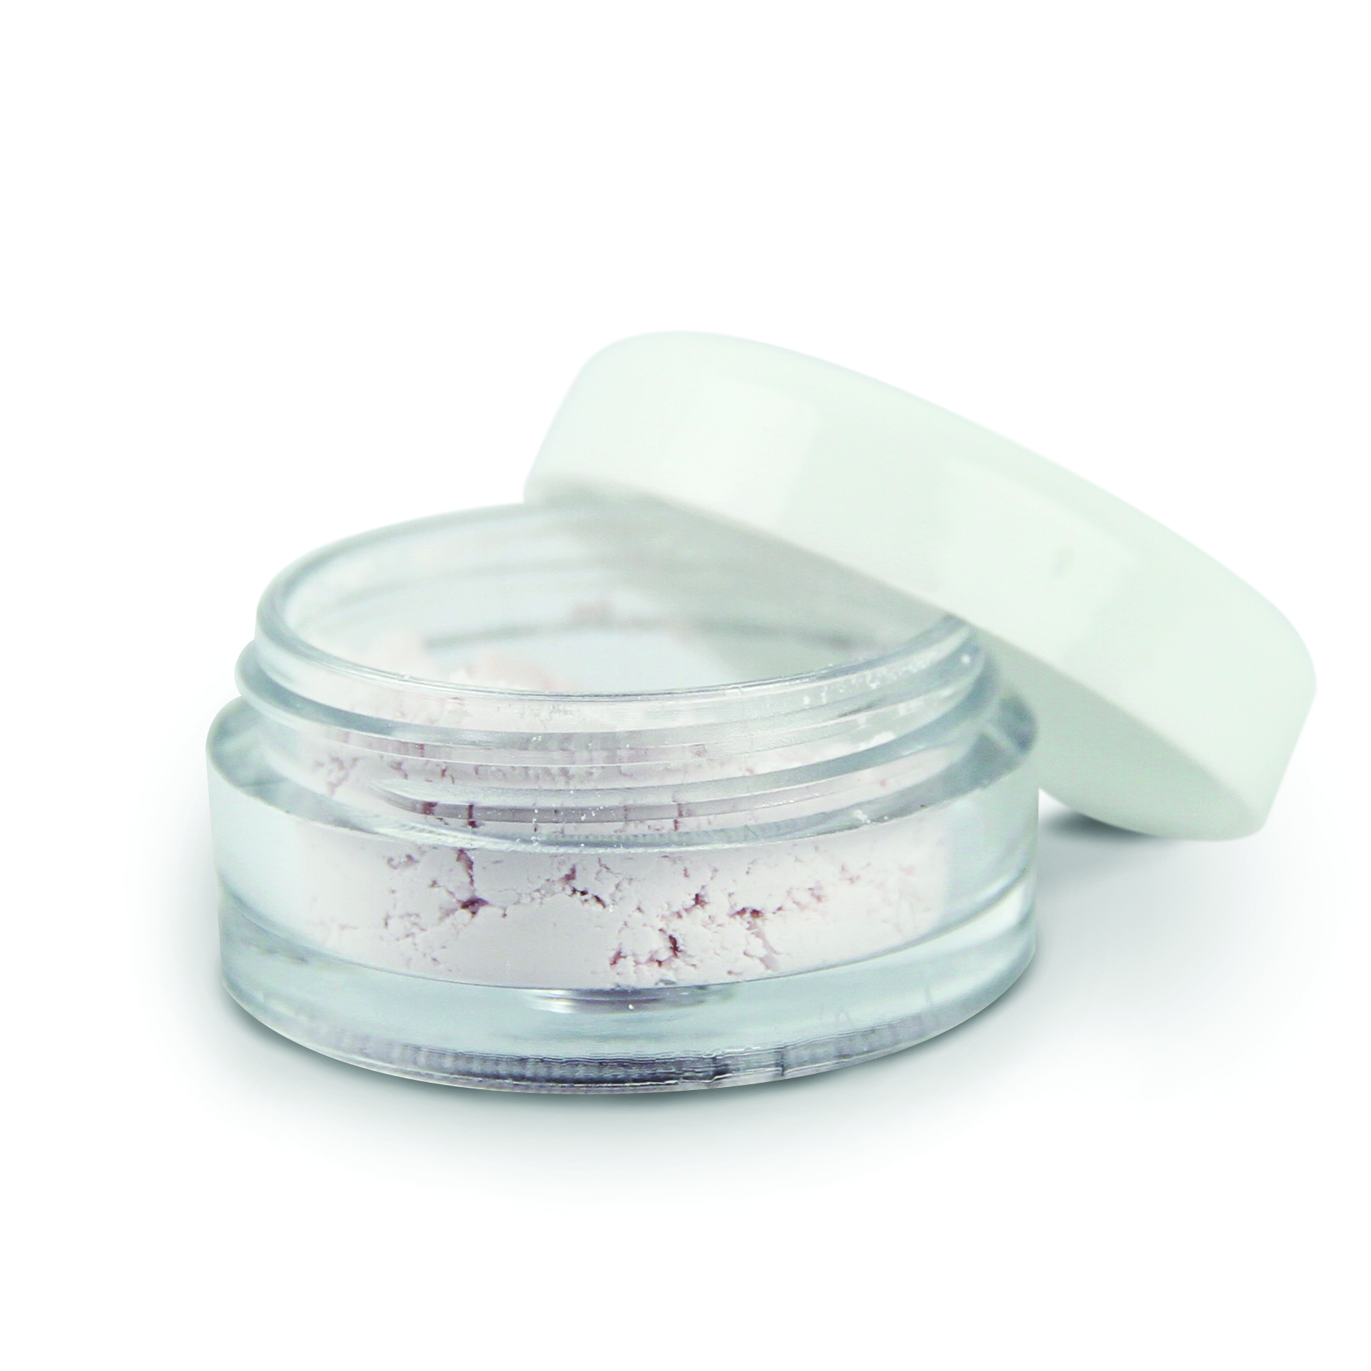
After-care Products

Slide 23
Sterex Witch Hazel
80% liquid extract of natural witch hazel
Mild astringent
Cooling on the skin and mildly bactericidal
Use for first 24 to 48 hours
Soothing and healing
Moisturising properties with added humectants
Popylene Glycol and Carbomer
Cross selling opportunities, e.g. Insect bites and cuts
Available in 200ml tubes and boxes of 10 35ml tubes
Notes:
Mildly astringent causing tissue to contract to help shrink pores whilst also soothing the skin and relieving inflammation
A humectant is a substance that draws water into the skin, hair, or nails.

Slide 24
Sterex Aloe Vera
95% liquid extract of natural Aloe Vera
Soothing & healing
Stimulating action of cellular renewal and cellular regeneration
Contains lemon grass (an effective cleanser)
Carbomer acts as a humectant and moisturiser
Usage 48 hours plus
Perfect choice for any form of hair removal including electrolysis, laser, IPL and waxing
Ideal as a cold compress after treatment
Cross selling opportunities, e.g. after sun
Available in 200ml tubes, boxes of 10 35ml tubes and 1 litre pump bottle

Slide 25
Sterex Après Care
Contains antibacterial properties
Soothing properties
Perfect for areas of high bacterial growth
Usage 24 to 48 hours
Cross selling opportunities, e.g. Acne, congested skin types

Slide 26
Calamine Powders
Soothing antiseptic powder
Relieves redness, stinging and inflammation of the skin
Derived from natural mineral deposits and ferric oxide
Effective at reflecting UV rays, protecting the skin from sun damage.
It is absorbent and has drying effect on skin
Quickens appearance of healing crusts after blemish treatment

Slide 27
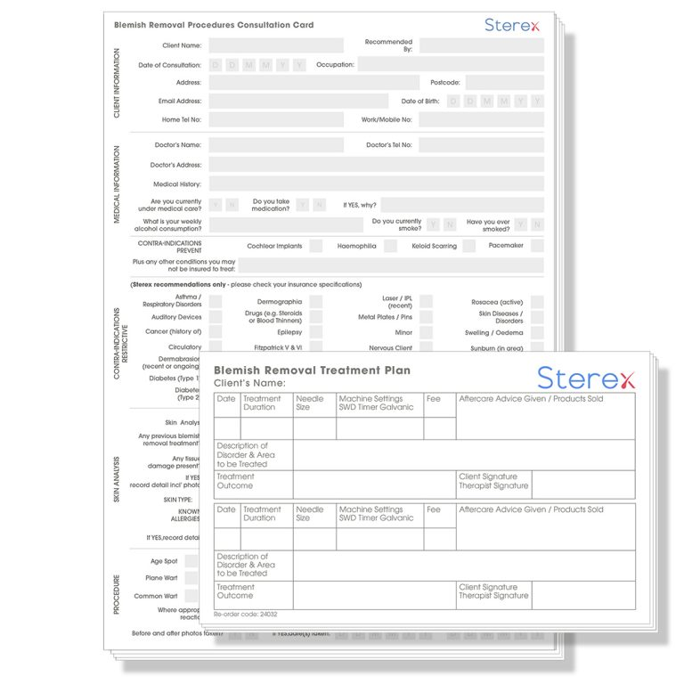
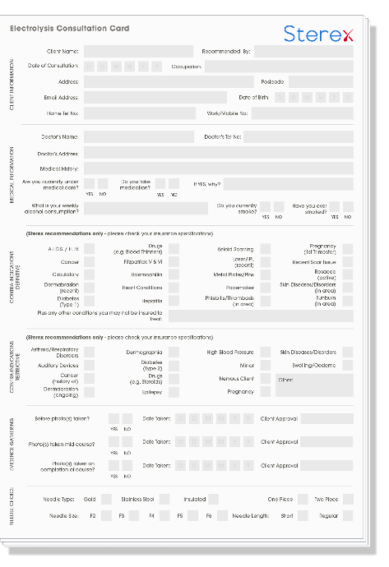
Consultation & Treatment Records
Designed for both electrolysis and advanced treatments
Consultation is crucial before carrying out the electrolysis treatment
The record card will assist client understanding
Will act as an aide memoire when explaining the process to clients
Ensures that you do not perform any treatments that are detrimental to the clients health
Is a written history of important information relating to the clients health, treatments and relevant events
Protects both the client and electrologist
Is an insurance requirement
Consultation Pads and Combined consultation and record pads available in pads of 25

Slide 28
Aftercare Leaflets
Designed for both electrolysis and advanced treatments
Written aftercare instructions are an insurance requirement
Provision for recording future appointments
Electrolysis after care leaflets are available in packets of 25
Advanced after care leaflets are available in packets of 25

Slide 29
Skin & Hair Charts
Available in A4 & A2 laminated
A4 also available non laminated
Excellent visual aid for explaining to clients:
treatment
hair growth cycle
follicle distortions
where follicles are positioned
direction and angle of needle insertion

Slide 30
Skin Blemish Removal with Diathermy
A practical guide to Levels 4 and 5 qualifications
Companion text book to L4 and L5 courses
Reference book for existing practitioners
Treatment hints and tips
Case studies
MCQ
Research ideas

Slide 31
Sterex Training Courses
VTCT L3 Electrolysis Course for beginners
VTCT L4 Award in Skin Blemish Removal
Advanced Cosmetic Procedures
VTCT (ITEC)L5 Certificate Advanced Blemish Removal
Refresher Courses
Specialist Electrolysis Transgender
For further details
E: training@sterex.com or
T: 0121 708 4137/5111

Slide 32
THANK YOU

